Slide 1

A Simple Music Player App
Đặng Hữu Phúc
UID: 2031200057

Slide 2
Table of contents
01
02
03
04
05
06
Introduction
Functions
Libraries
Screens
Progress
Points to improvement

Slide 3
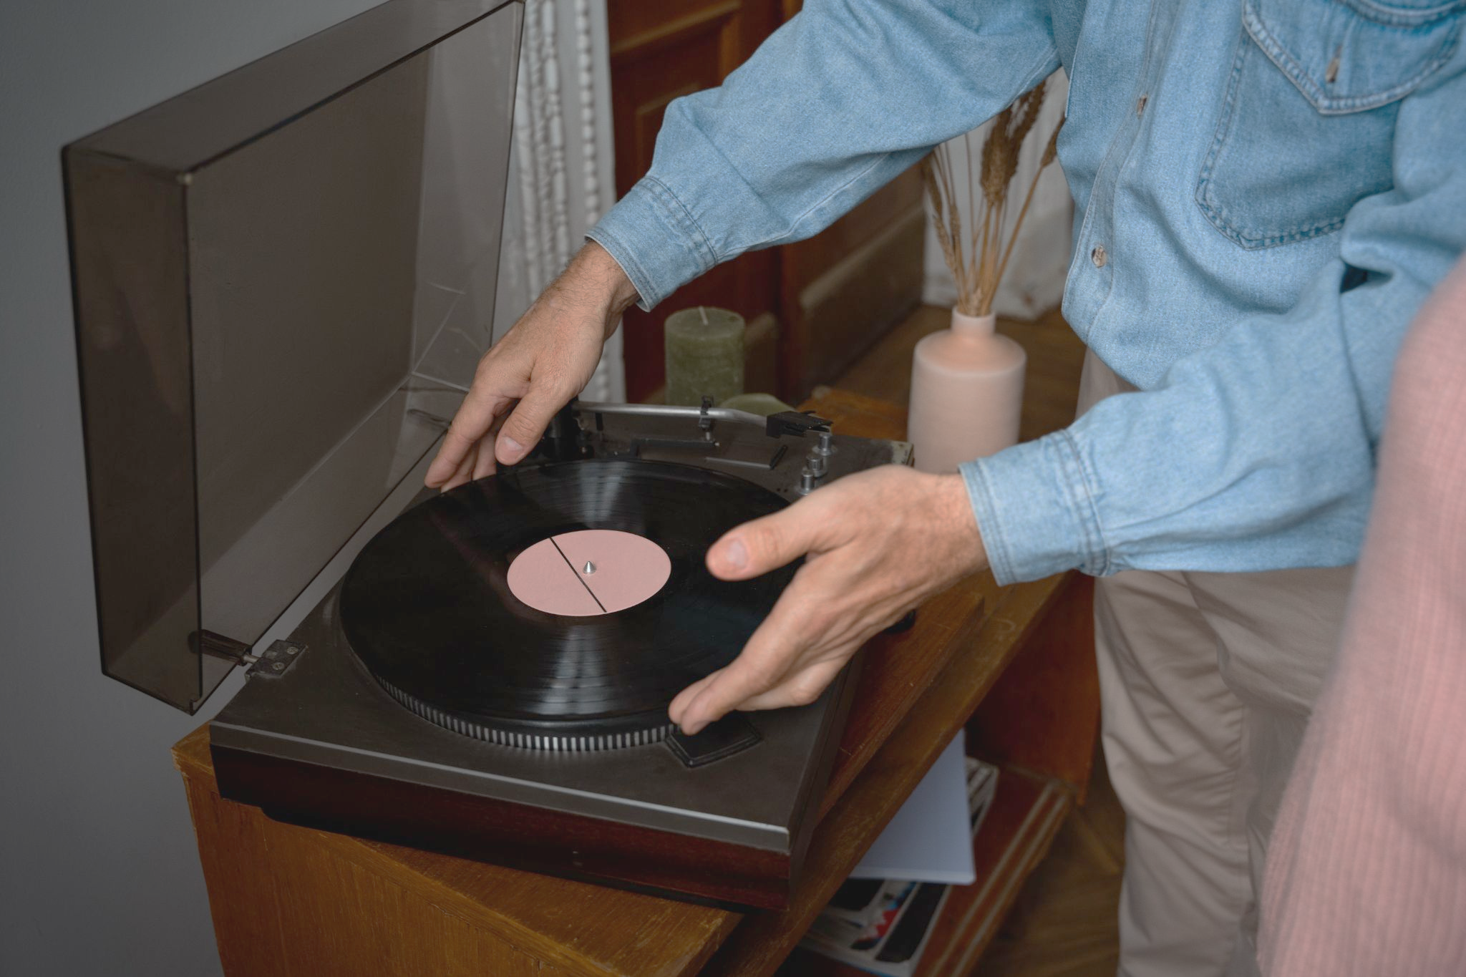
Introduction
This is a simple application for individuals
Aim:
Providing a music player media for users
Users can add songs which they enjoy

Slide 4
Functions
Play music
Add to/Delete from Favorites
Add to/Delete from Queue
Be able to repeat one track or all playlist

Slide 5
Libraries
react-native-track-player
axios
AsyncStorage
react-native-pop-up-menu
react-navigation/stack
react-navigation/bottom-tabs
react-navigation/material-top-tabs
react-native-vector-icons
@react-native-community/slider

Slide 6
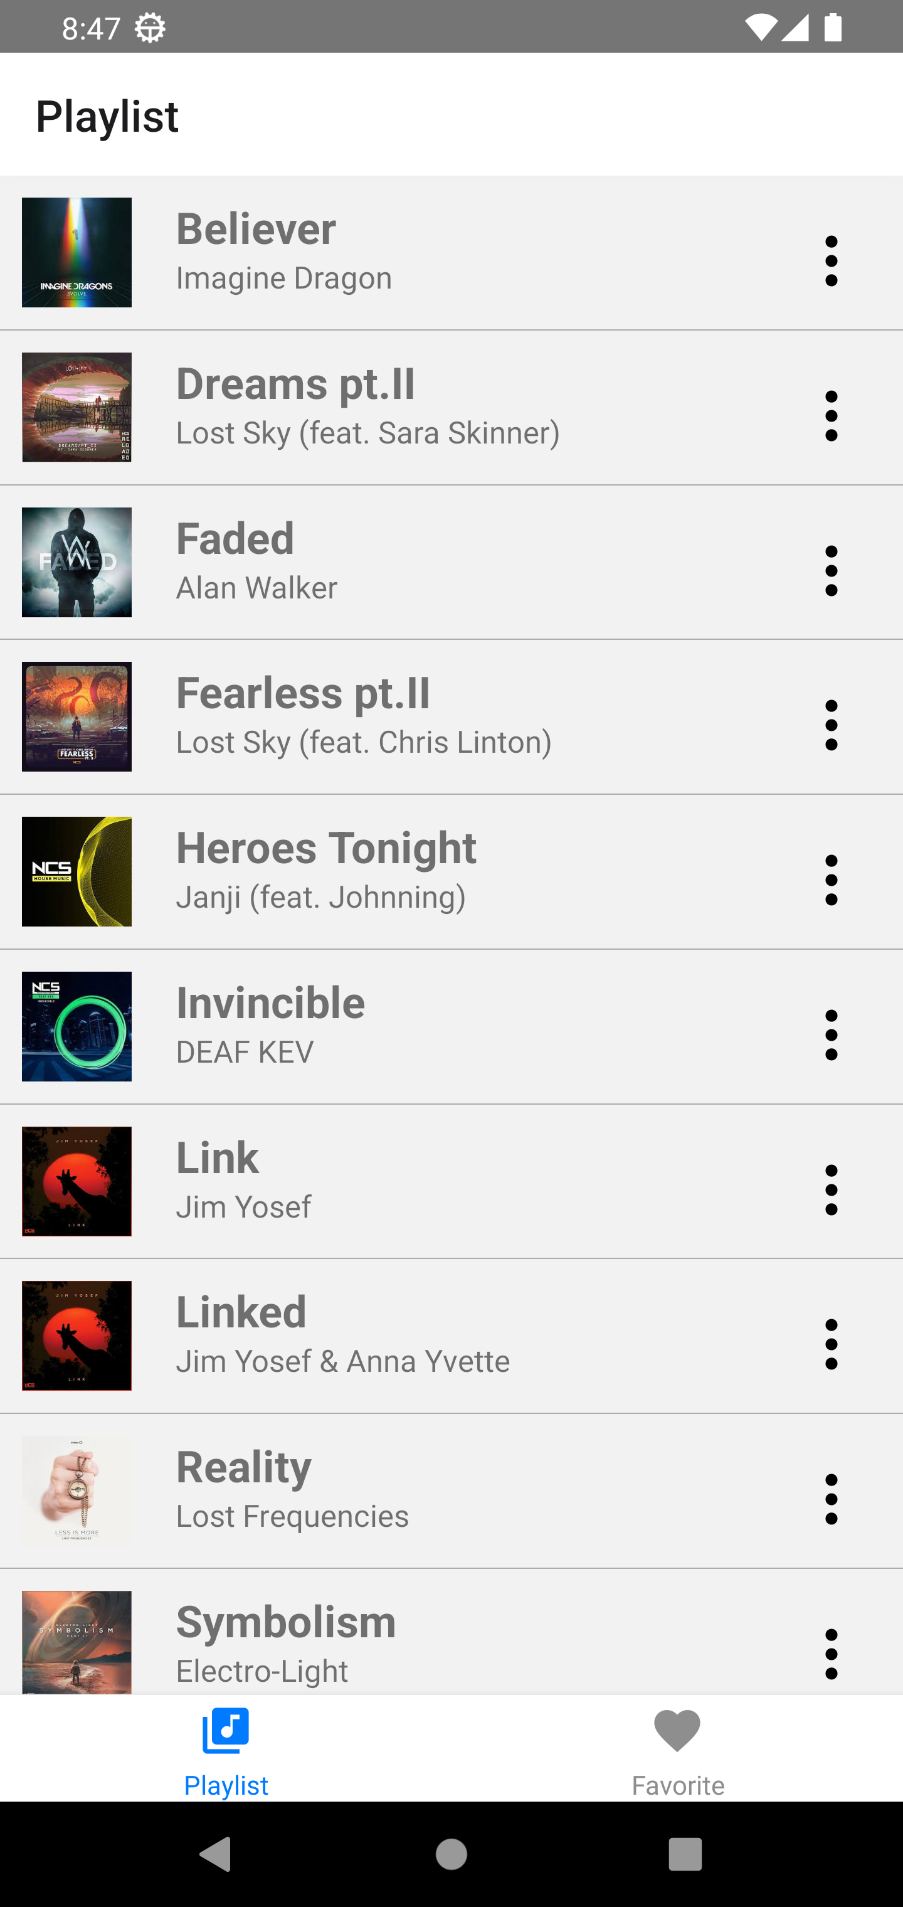
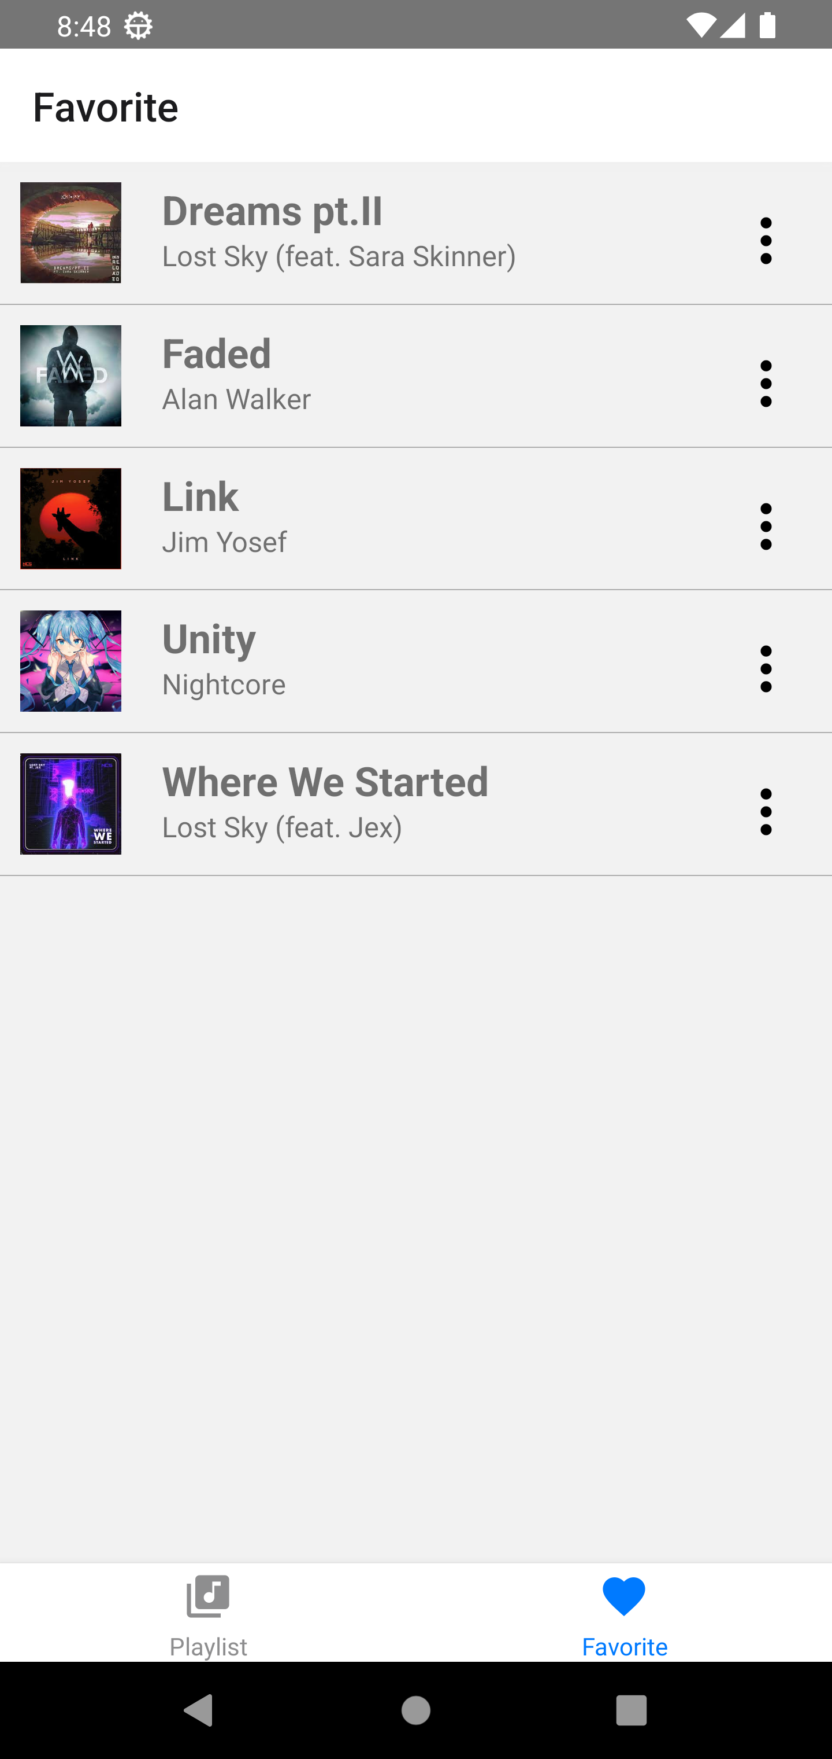
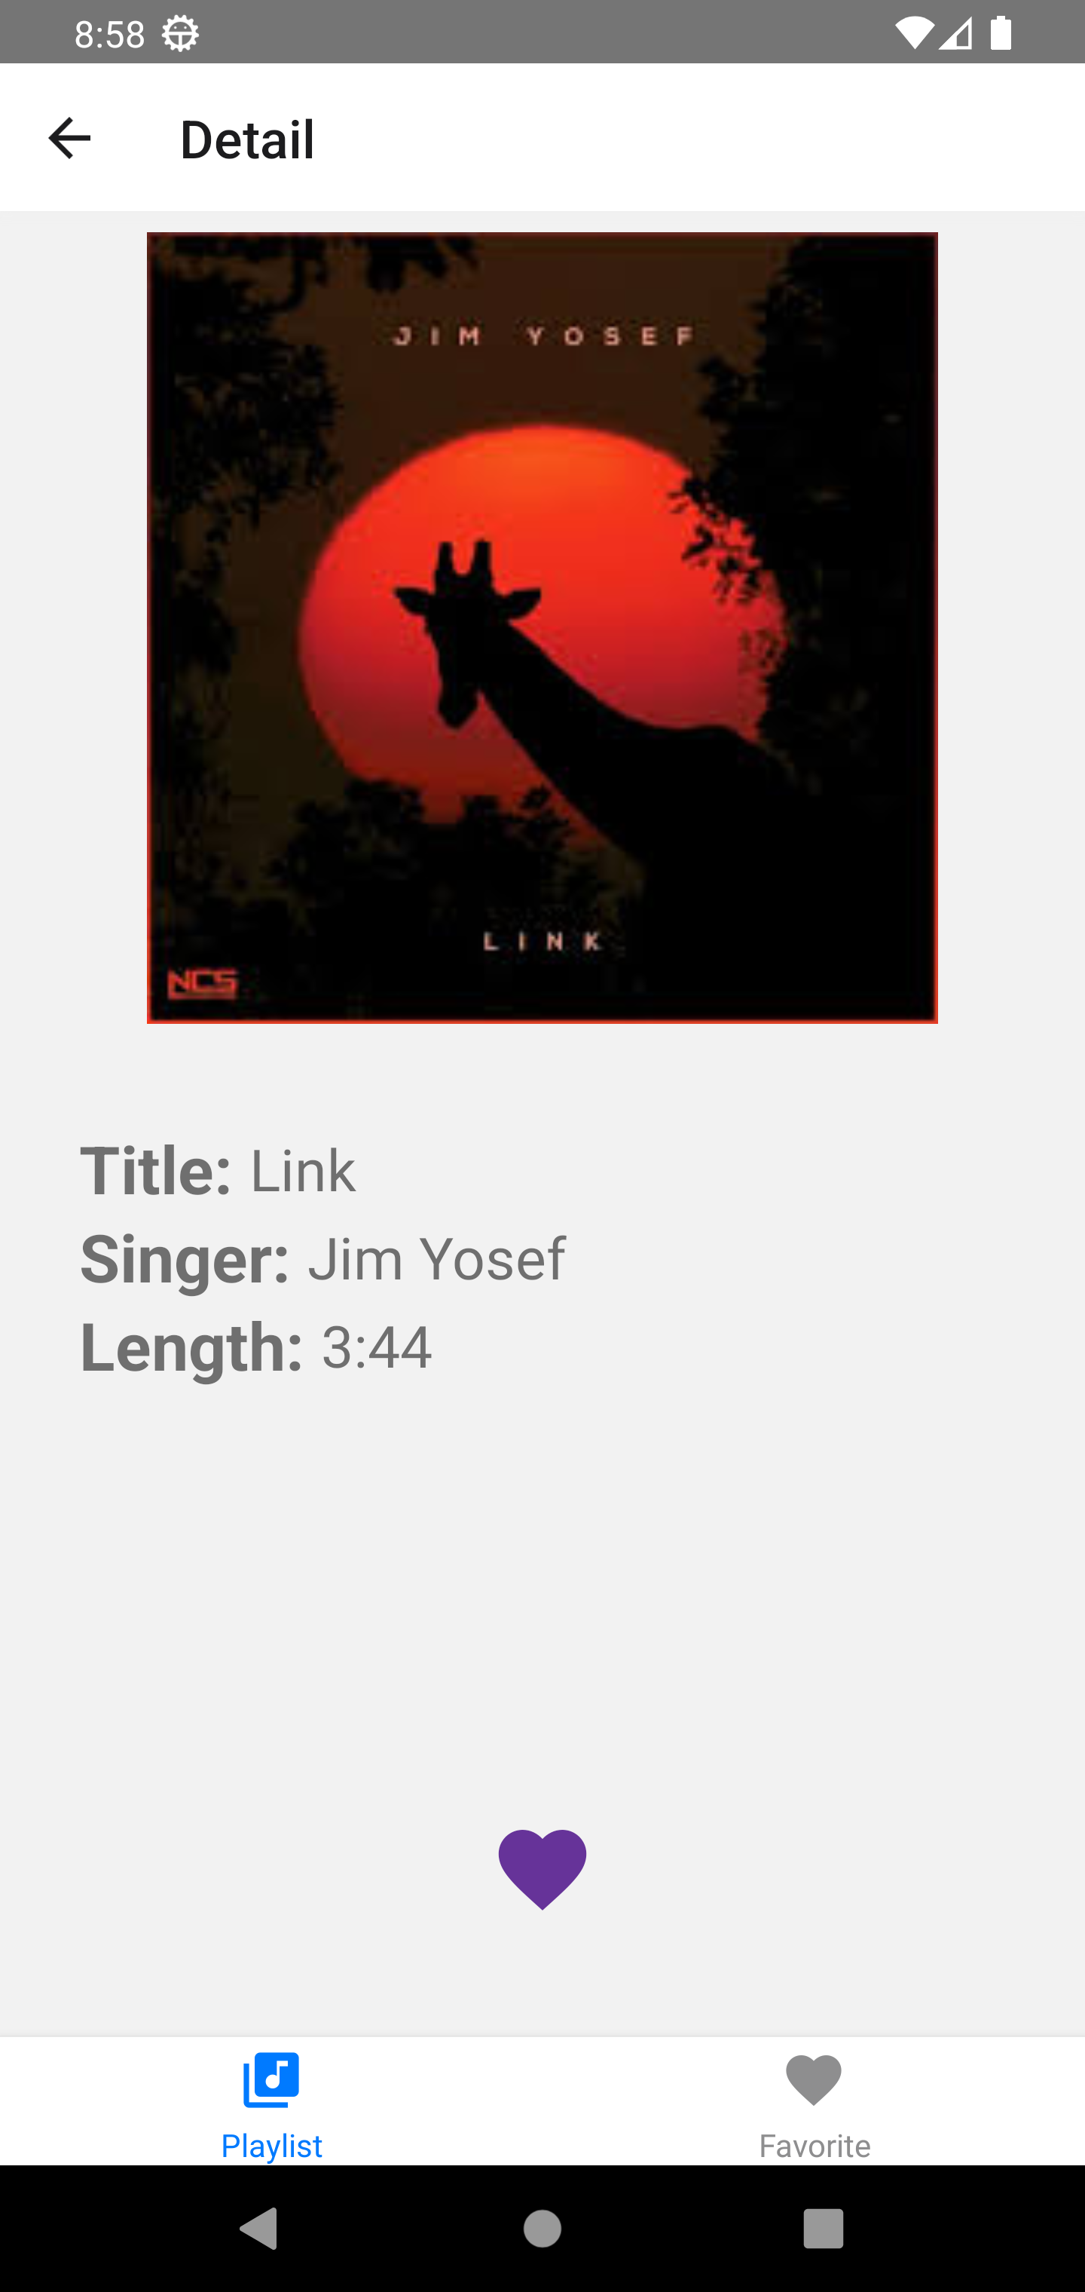
Screens
Playlist Screen
Favorite Screen
Detail Screen

Slide 7
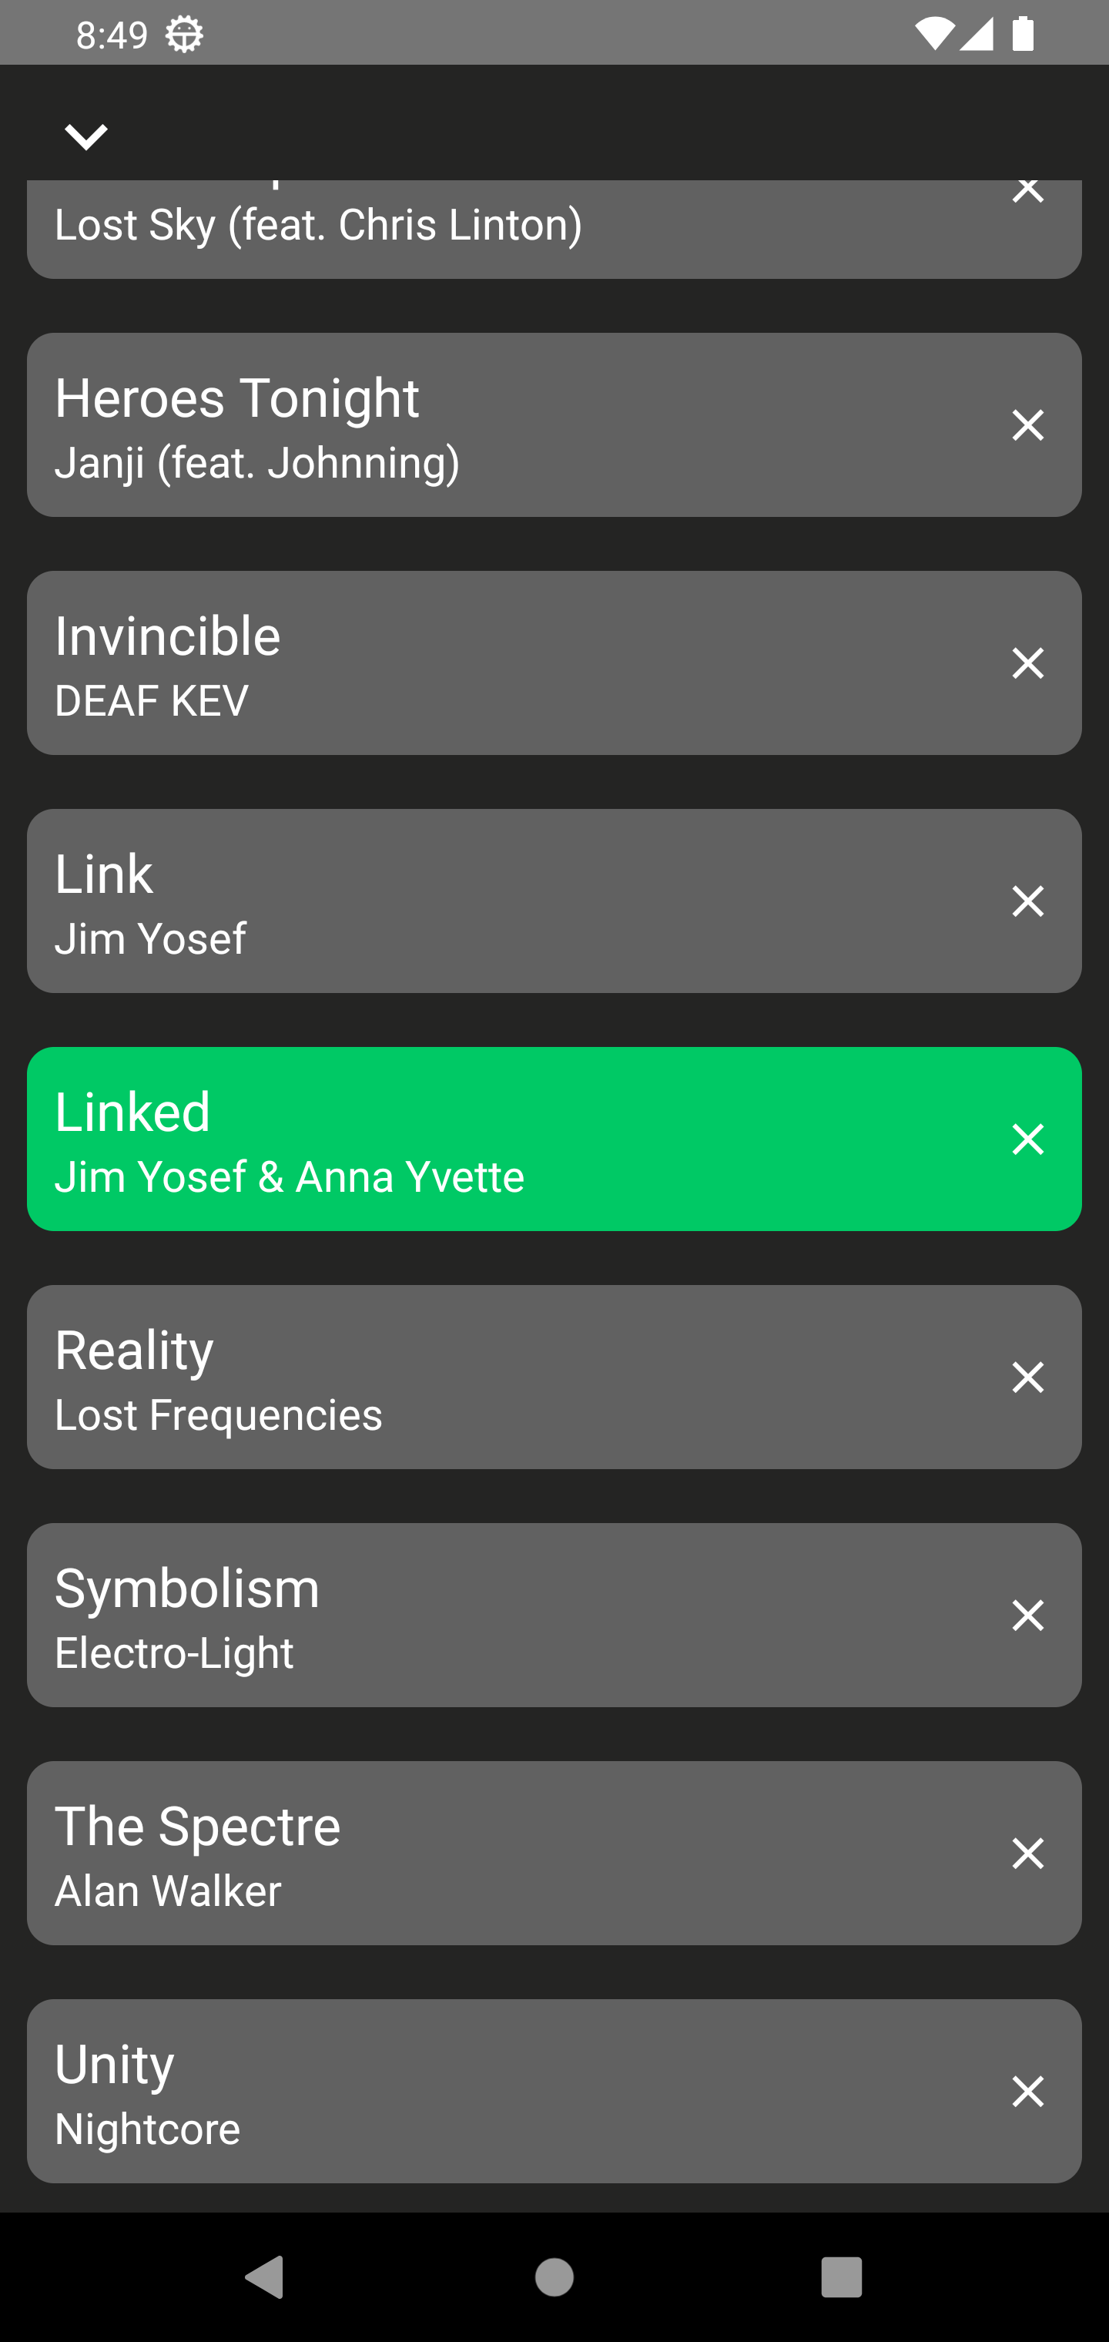
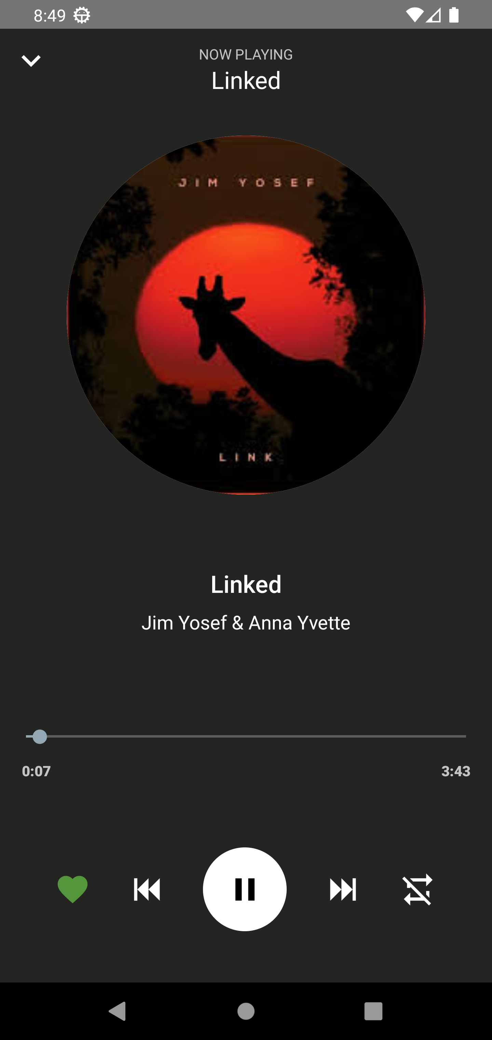
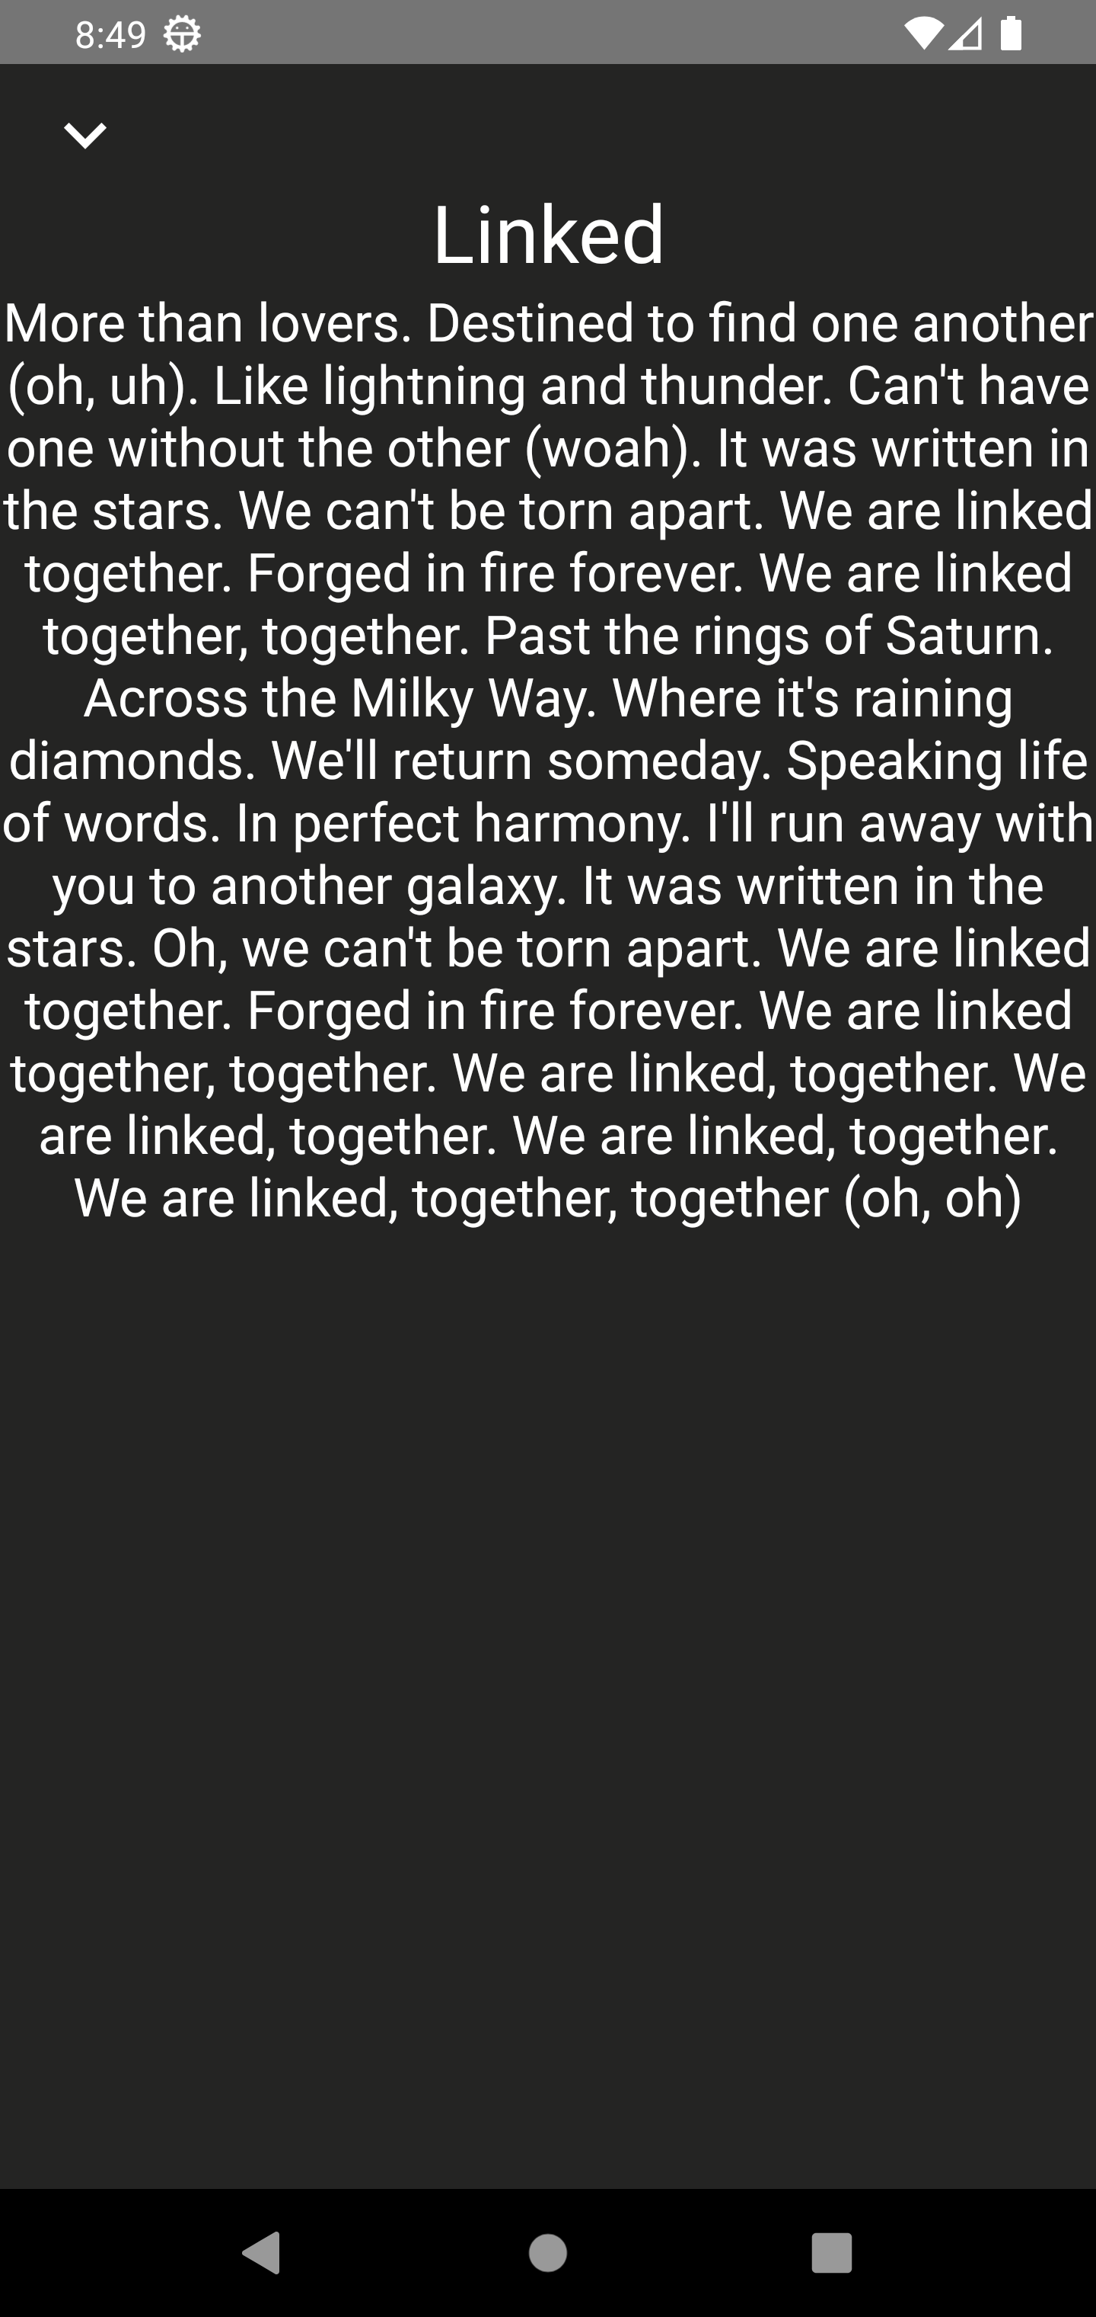
Screens
Queue Screen
Playing Screen
Lyric Screen

Slide 8
Progress
Step 01
Step 02
Step 03
Create JSON file, upload musics and images to host
Design Playlist, Favorite, Detail Screen
Do add/delete favorite songs
Step 07
Step 06
Step 05
Step 04
Do add/delete queue
Handle event to change layout and info of a playing song
Setting TrackPlayer and play song
Design Playing, Lyric and Queue Screen

Slide 9
Points to improvement
Add shuffle mode
Use Web API to upload songs from outside
Create an own playlist to add and delete songs
Add checkbox to delete many songs from queue
Add notification

Slide 10
Thanks for listening

Slide 11
Video Demo

